Slide 1
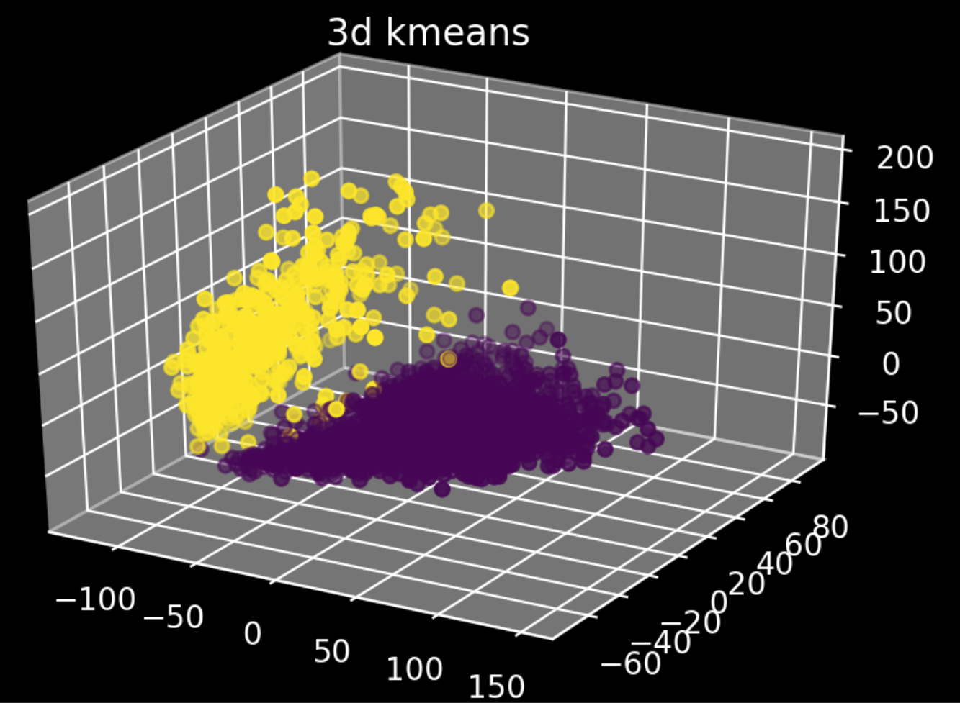
K-means clustering project proposal
Data analysis project 4, group 2

Slide 2
Table of contents
Information on the dataset
Filtering of data
Progress and results
Future plans

Slide 3
3K PBMCs from a healthy donor
By 10x Genomics
Contains single cell gene expression data
Dimensions: 2700 cells, ~32700 genes
PBMCs (Peripheral blood mononuclear cells):
T cells
B cells
NK cells
Monocytes
Data was obtained using Illumina NextSeq500

Slide 4
Filtering
Raw data
2700
32700
Removal of cells that were not expressed in any cells
2700
16600
Removal of outliers by Isolation forest algorithm (optional)
2511
n
PCA
2700
n

Slide 5
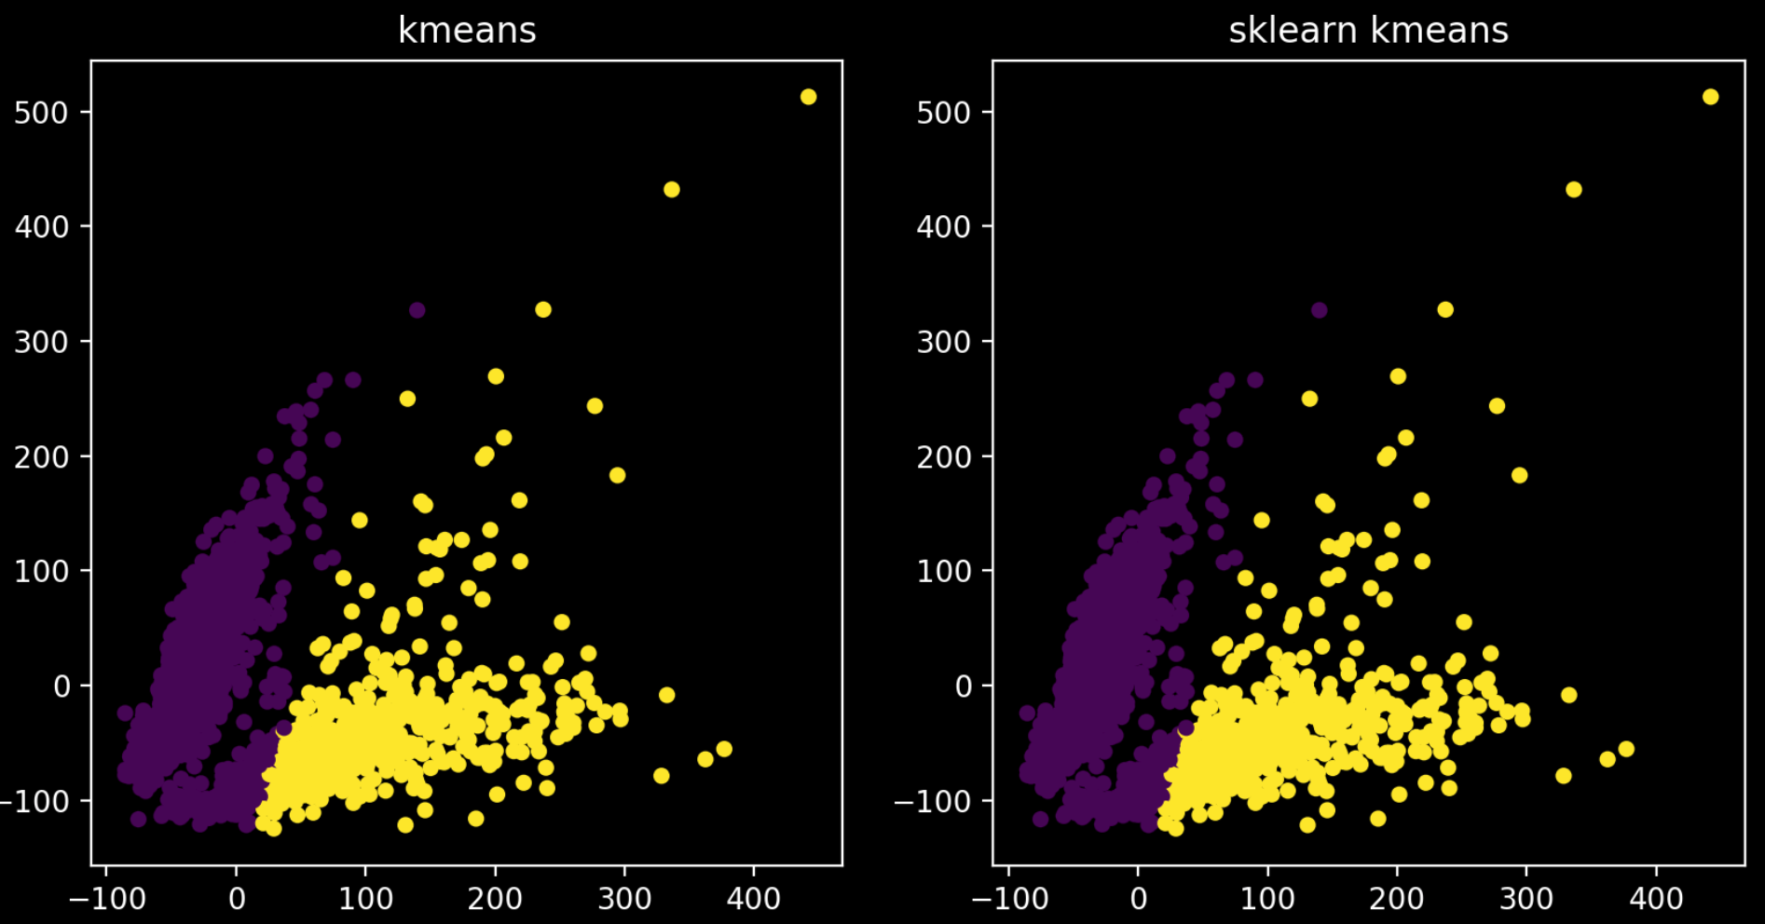
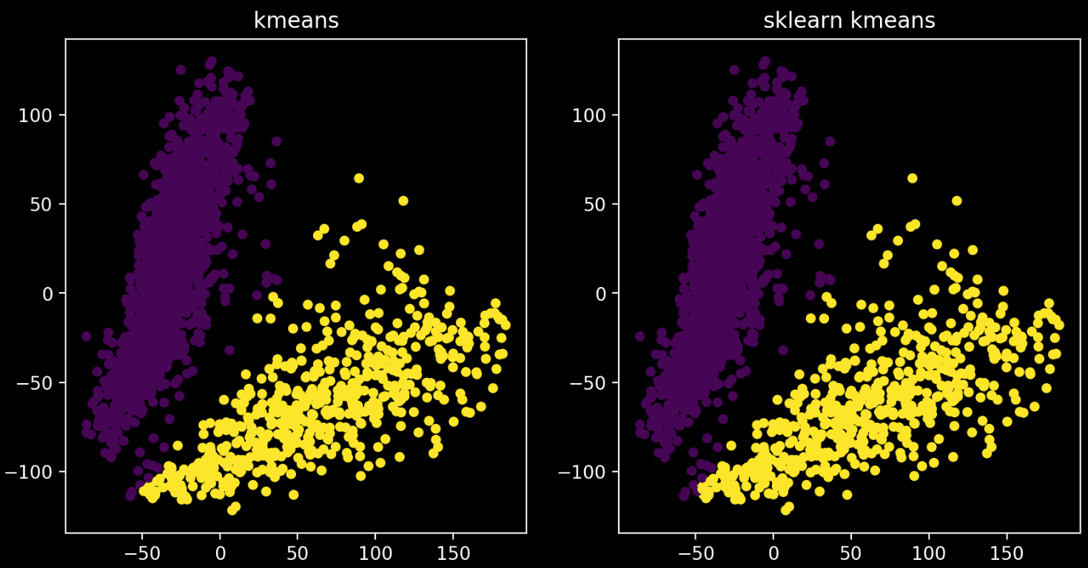

Slide 6
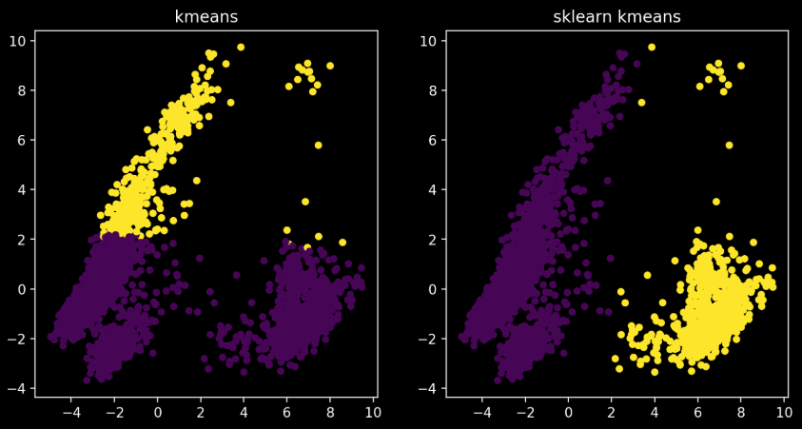
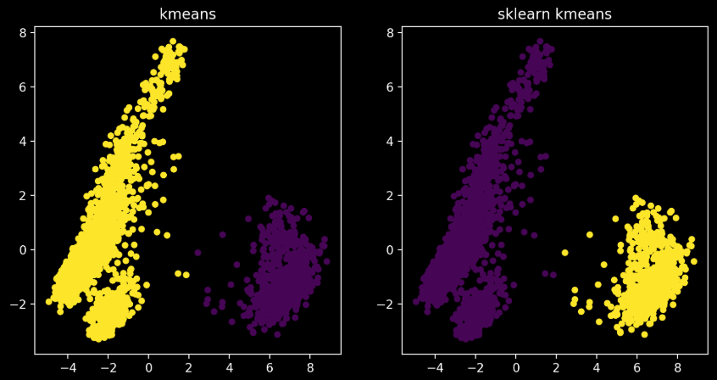

Slide 7
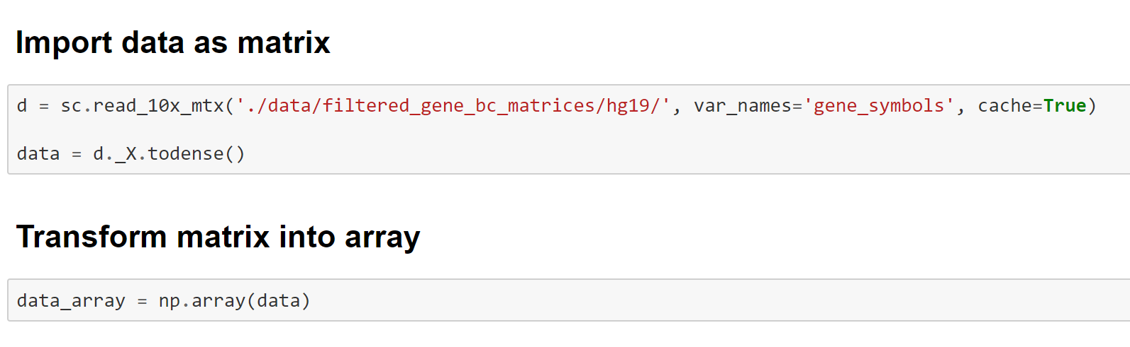
Data modifications
Improve usability of data
Convert matrix into array
Decrease Inertia by modifying data
PCA
Removal of outliers
Normalize or scale data differently ?

Slide 8
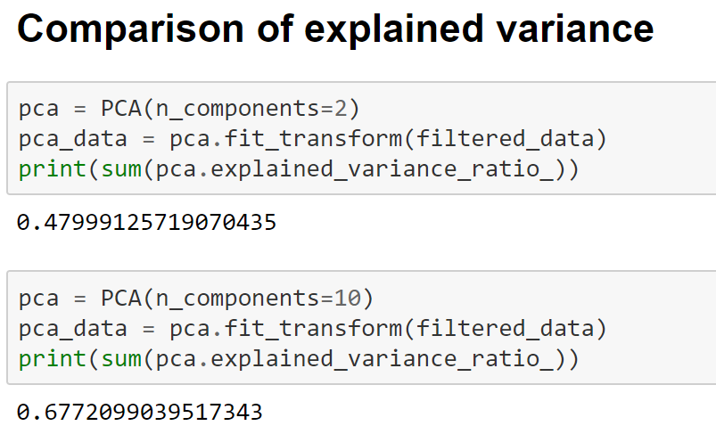
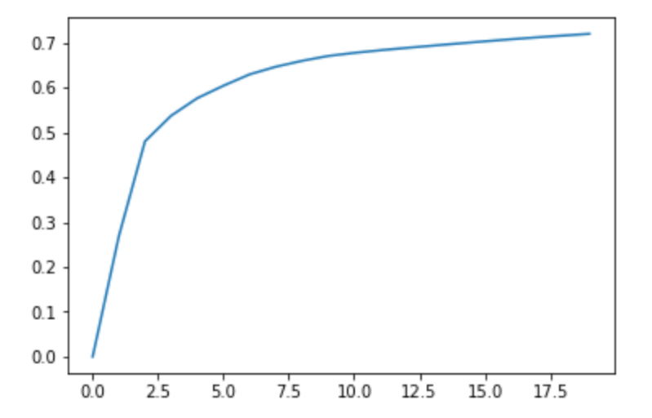
Principal component analysis
Break curse of multidimensionality
Reduction to array with significantly less dimensions
Allows better clustering and visualization

Slide 9
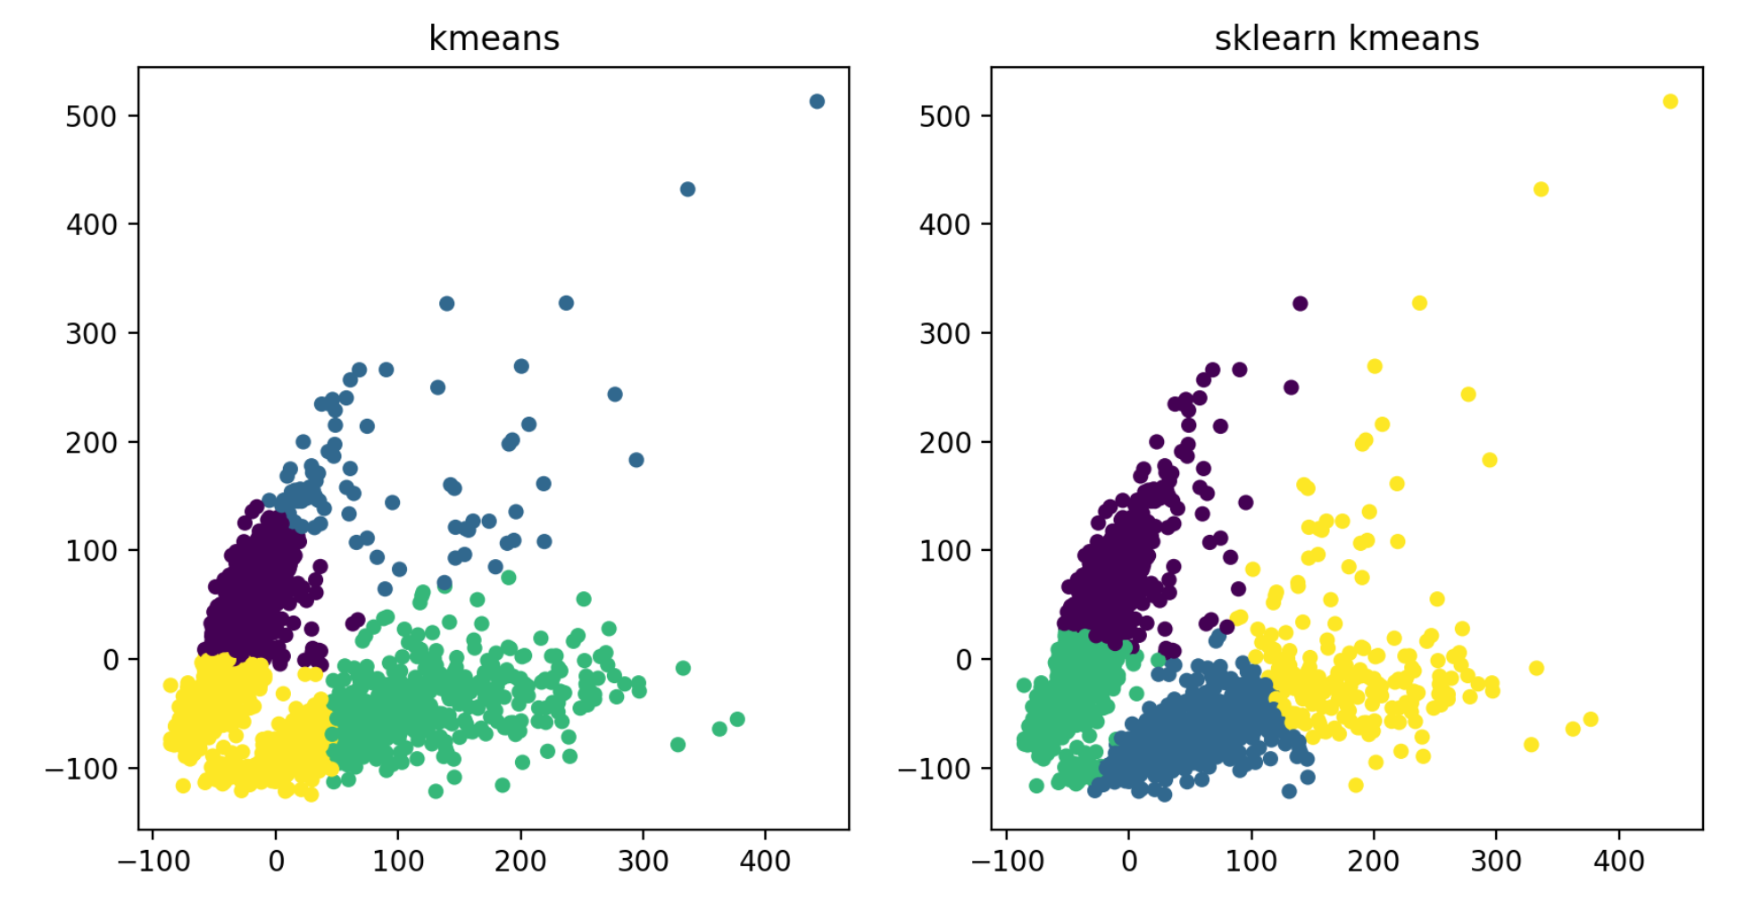
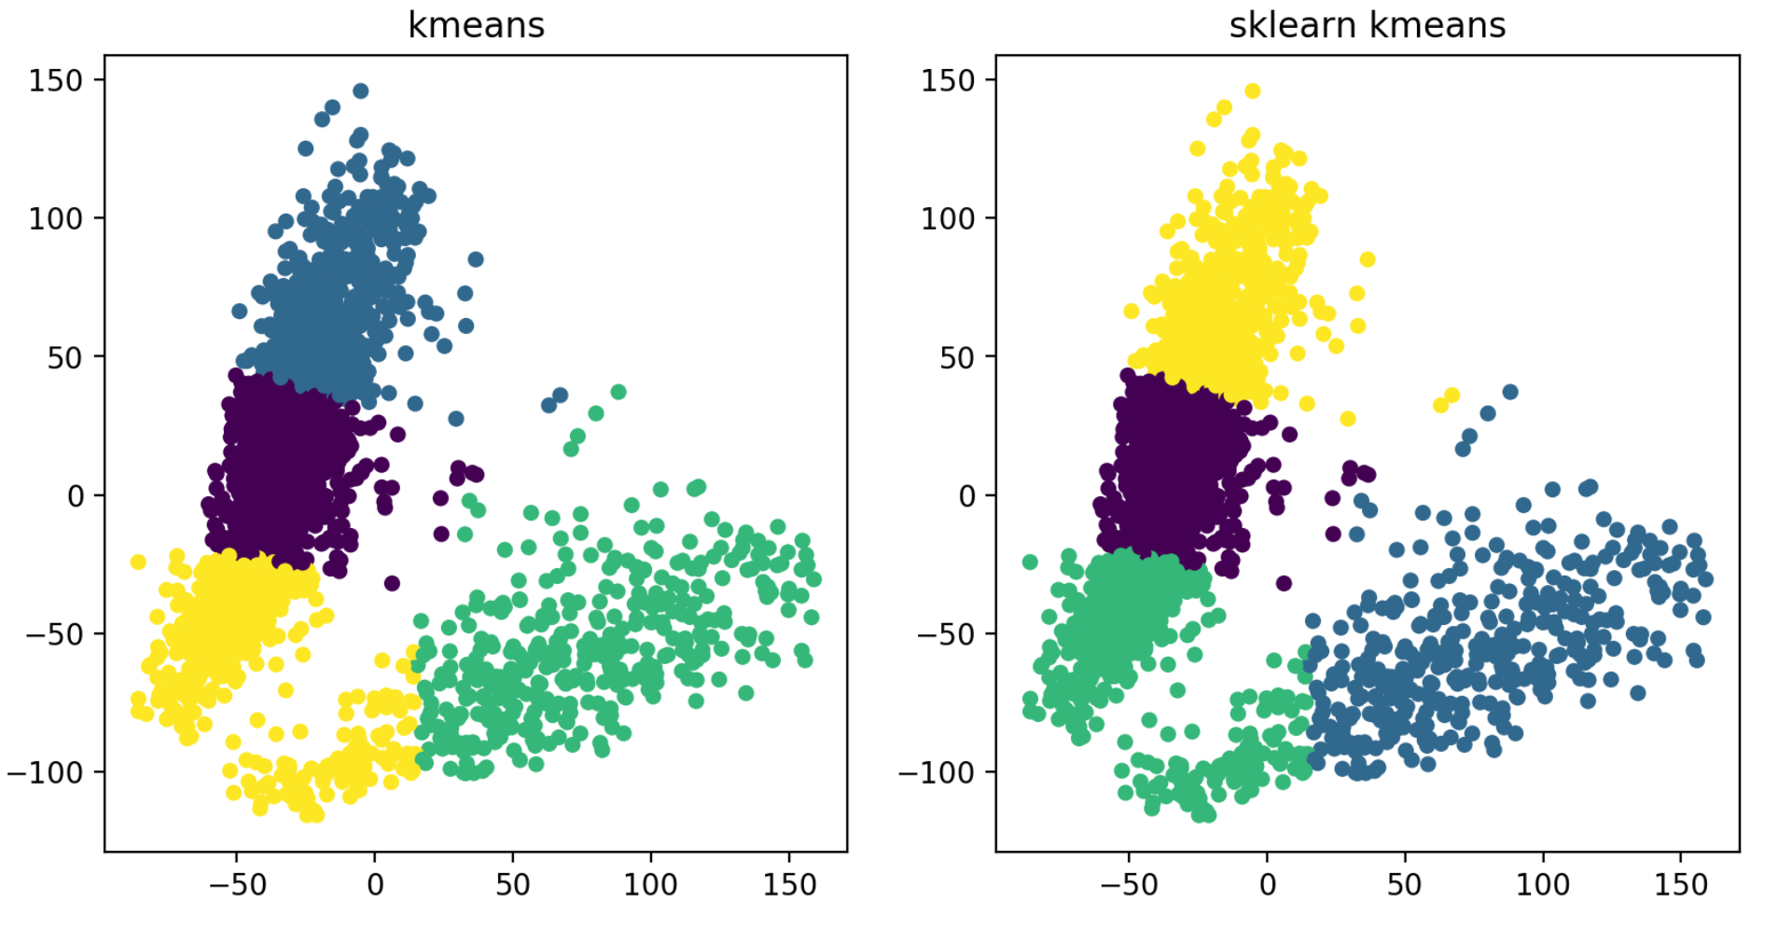
Removal of outliers
Reduces cluster elongation
Reduces inertia
Improves reproducibility

Slide 10
Progress and results
Import data
Filter data
PCA

Slide 11
k-means
Centroid generation
Assignment of all PBMC data ‚points‘ to the closest centroid
Update centroid location
New centroid location is mean of all previously assigned PBMC locations
Plotting
Generation of start location for the first iteration of cluster assignment
Cluster assignment
First iteration: Check for empty clusters when using randomly generated centroids
Pick random cells / generate random
2D / 3D

Slide 12
Optimization
How should we calculate distance?
Should we pick our centroids from the sample or generate new ones?
Find the optimal value for k

Slide 13
Future tasks
Mini-batch k-means
How can we pick the mini-batches in practice?
K-means ++
How do we implement a probability into our algorithm?

Slide 14



Logarythmic scaling or normalizing ?
Hier kommt ein bild von diesen hübschen neuen skrattar Plots hin
Das vermutlich erst ans ende

Slide 15
Today May Juni July
Basic K-means
Mini-batch
K-means ++
Clean-up duty

